Slide 1
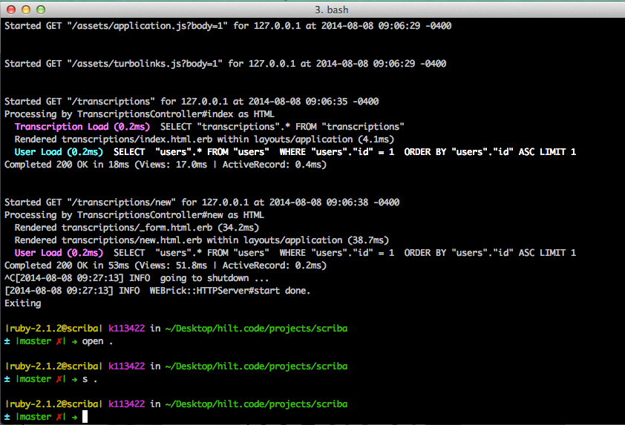
Humanities Programming
#hilt2014
@wayne_graham, @walshbr

Slide 2
Humanities Programming
Kevin Smith @KevinG_Smith
Norah Andrews @NorahLAndrews
Michelle Tiedje @michelletiedje
Zoe LeBlanc @Zoe_LeBlanc
Abby Schreiber @abschreiber
Katherine Katsirebas
Steve Anderson @sgahistory
Arden Kirkland @ardeninred
Yuko Nakamura @yukonakamura_
Ethan Reed @reedeth
Andrew Keener @keenera
Angela Galvan @galvan_as
Ben Daigle @bendigle
Jacob Heil @dr_heil
Jenifer Bartle
Tatiana Ausema @modernmatters
Lee Zickel @bewmaynes
Crystal Hall
Bradley Nelson @bradleymnelson
Trevor Berman @TGBerman
Instructors
Landon Donovan @landondonovan
Dwyane Wade @DwyaneWade

Slide 3
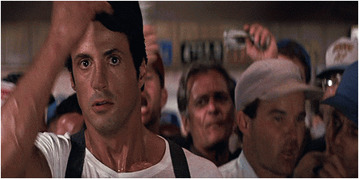
First thing’s first…
<Code Champ>

Slide 4

First thing’s first…
Federated Lineating Nodal Executioner

Slide 5
First thing’s first…
Holder of the FeLiNE Belt

Slide 6
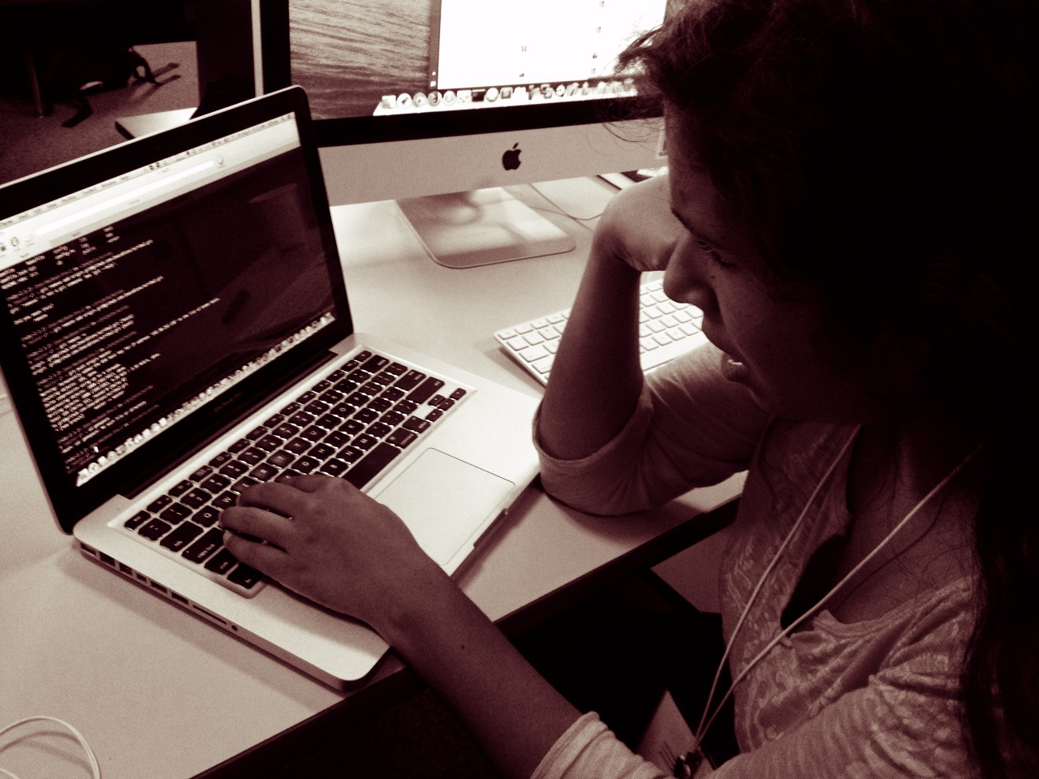
We learned….
>_
… the command prompt

Slide 7
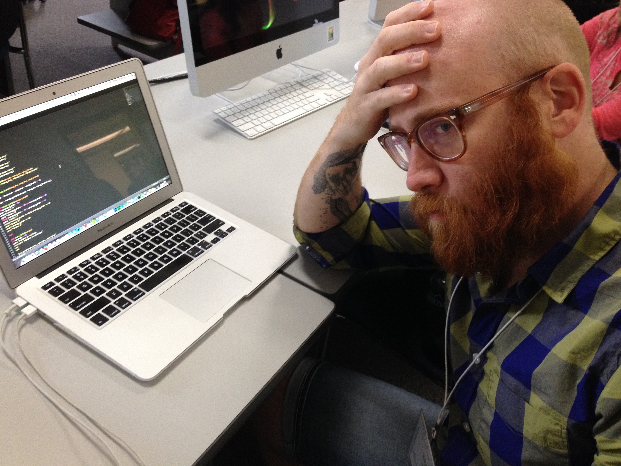

We learned….
We learned….
… text editors.

Slide 8
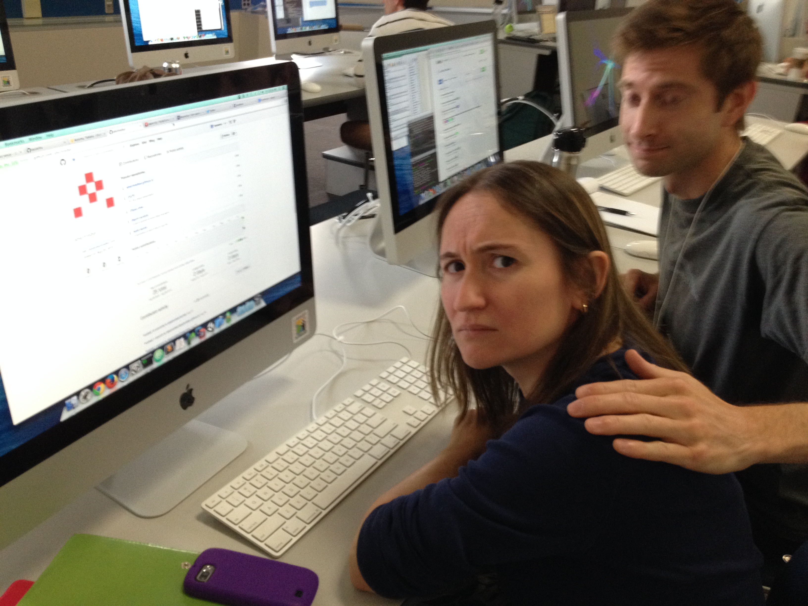

We learned….
We learned….
… GitHub

Slide 9
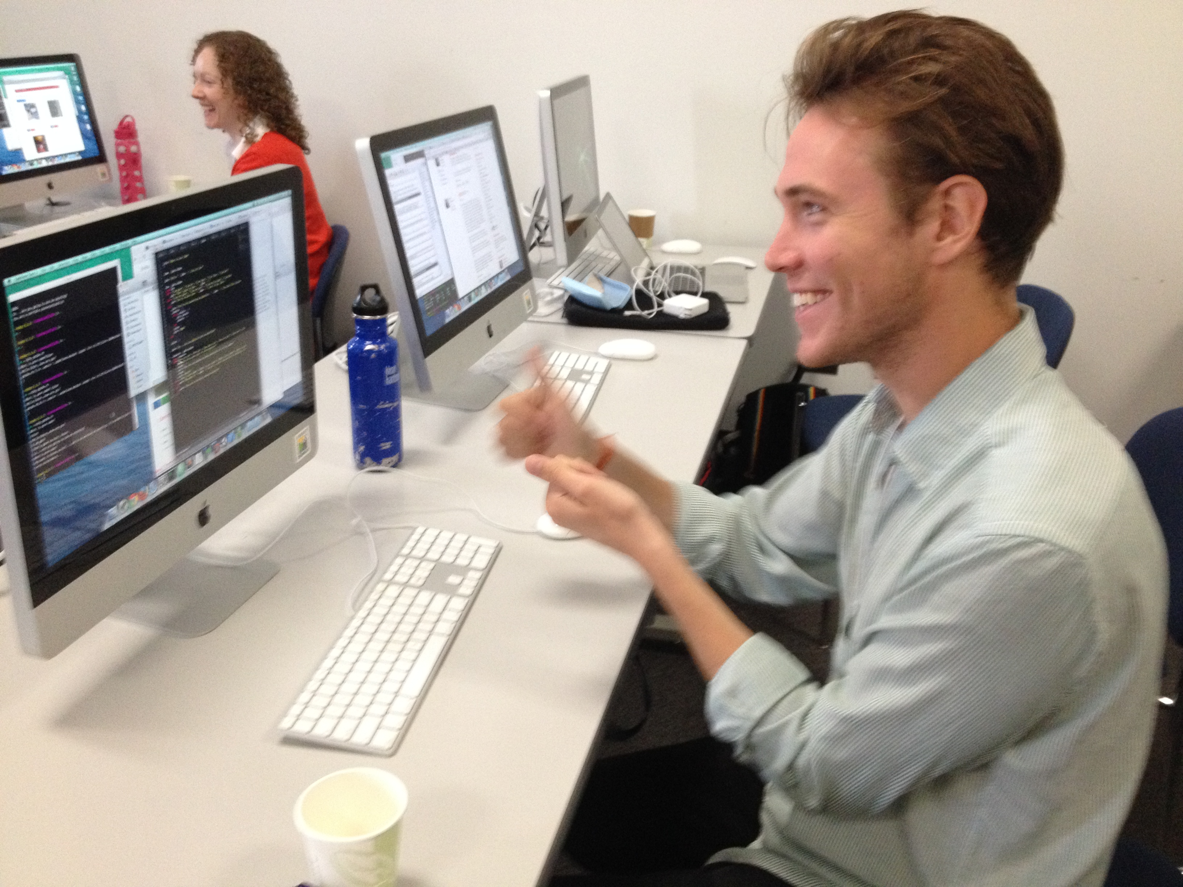

We learned….
We learned….
…interactive ruby.

Slide 10
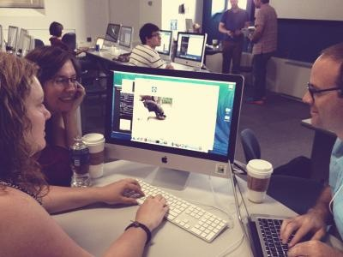

We learned….
… rails

Slide 11
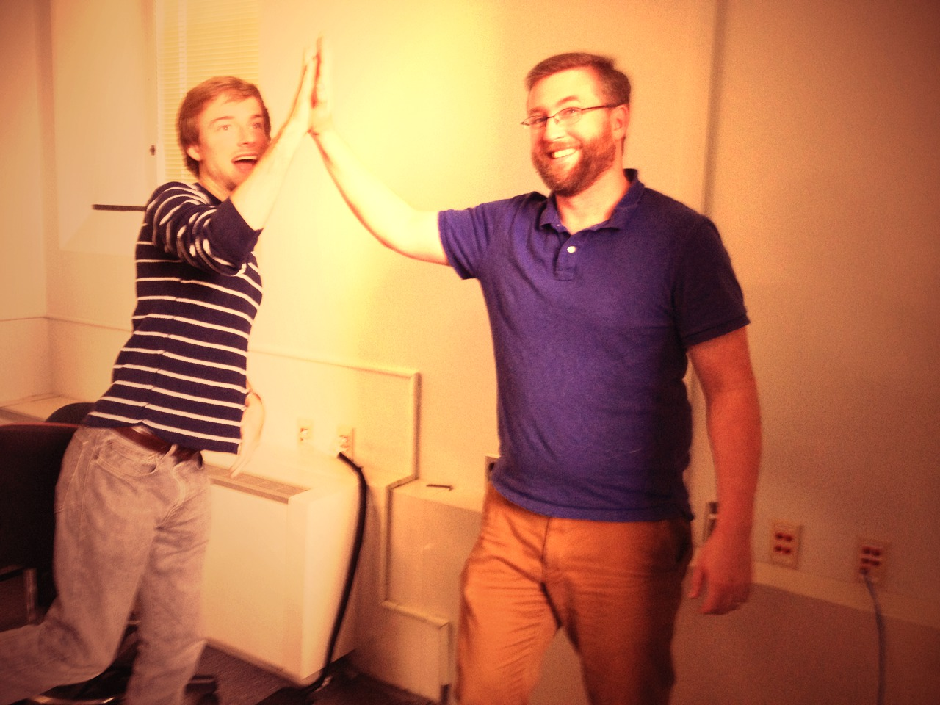

Slide 12
Humanities Programming
Kevin Smith @KevinG_Smith
Norah Andrews @NorahLAndrews
Michelle Tiedje @michelletiedje
Zoe LeBlanc @Zoe_LeBlanc
Abby Schreiber @abschreiber
Katherine Katsirebas
Steve Anderson @sgahistory
Arden Kirkland @ardeninred
Yuko Nakamura @yukonakamura_
Ethan Reed @reedeth
Andrew Keener @keenera
Angela Galvan @galvan_as
Ben Daigle @bendigle
Jacob Heil @dr_heil
Jenifer Bartle
Tatiana Ausema @modernmatters
Lee Zickel @bewmaynes
Crystal Hall
Bradley Nelson @bradleymnelson
Trevor Berman @TGBerman
Instructors
Landon Donovan @landondonovan
Dwyane Wade @DwyaneWade

